Slide 1


親子關係轉化愛中成長

Slide 2
你們作兒女的, 要在主裏聽從父母…弗6:1
兒女是耶和華所賜的產業…詩127:3
教養孩童, 使他走當行的道…箴22:6

Slide 3

親子關係轉化愛中成長
親子關係的認識
A.父母與兒女 (弗6:1)
B 管家與產業 (詩127:3)
C.老師與學生 (箴22:6)

Slide 4



親子關係轉化愛中成長
親子關係的挑戰
A. 為孩子設立界限
B. 處理越界限行為

Slide 5
親子關係轉化…
愛中成長

Slide 6
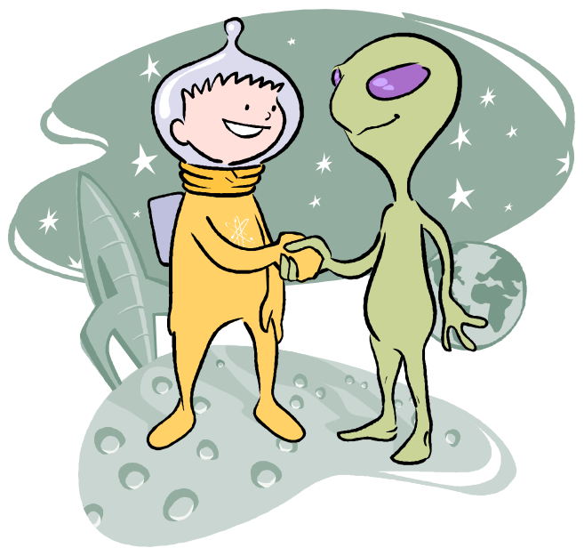
Communicating with Aliens
與外星人溝通
Using the 5 Love Languages to speak encouragement into our kids’ lives.
用五種愛的語言對孩子生命說鼓勵的話。

Slide 7

The LOVE BANK
愛的銀行
Notes:
Discuss the idea that as we receive love, it’s like a deposit in a bank. When the bank is full the kid is full of self confidence and is better able to handle the pressures of life both positive and negative pressures.
Discuss the primary love language will replenish this bank much faster than others but ALL are helpful and needed.

Slide 8
Five Love Languages
五種愛的語言
Five most effective ways to fill your child’s Love Bank
五種最有效的方法,在您小孩愛的銀行裏存款.
Each person has one PRIMARY love language
每一個人都有他主要的愛語言.
Notes:
Go through each Language Talk briefly about what they mean.
After the description have Ruth share how knowing these different Languages has helped here with looking at each of her kids.

Slide 9

Words of Affirmation
肯定的言詞
Using words to encourage and love.
用話語去鼓勵和愛。
Be Sincere & Specific
要誠懇。要具體。
When you can’t praise results, praise effort.
當你不能讚賞結果，你仍然可以讚賞他的努力。
Give praise in front of family.
在家人面前讚賞他。
Notes:
Kids see through fakery
Praise effort - Do not compare kids to siblings, peers. This is one of the most frequent frustrations that kids communicate about their parents. “My Parents are never satisfied, they are always comparing me with this person or that person”

Slide 10
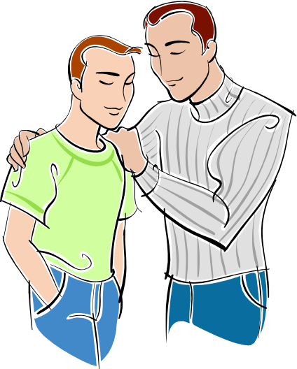
Physical Touch
身體的接觸
Using touch to communicate love and affirmation.
藉著接觸表達愛和肯定。
Be flexible, adapt to what your child likes.
有彈性，用孩子喜歡的方式。
Not in front of peers.
不要在他的朋友面前。
Learn when your child is sending the signal that it’s ok.
學看孩子的訊號什麼時候是可行的。

Slide 11
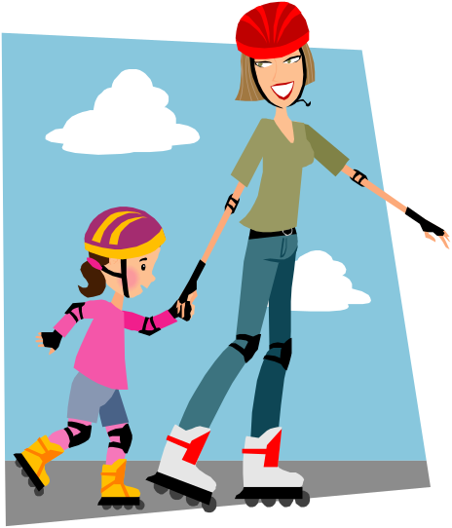
Quality Time
精心的時刻
Giving children your undivided attention.
給孩子不分散的注意力。
Giving children a portion of your life.
給孩子你生命的一部份。
Focus on child, not activity.
焦點在孩子，不在活動。
In conversation focus on listening.
在交談中焦點放在聆聽。
Notes:
Focus – doing an activity that the child has no interest in doesn’t count.
Review proper listening Many times all a teen wants is listening without advice.
1. Maintain Eye Contact when teenager is talking – communicates attention
2. Don’t listen to your teenager and do something else at the same time.
3. Listen for feelings
4. Observe body language
5. Refuse to interrupt
6. Ask reflective questions Repeat back to the teen what they are saying ,” What I hear you saying……..is this correct?
7. Express understanding.
8. Ask permission to share your perspective

Slide 12
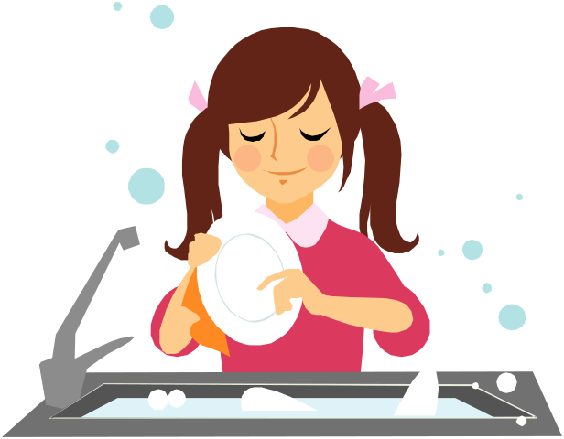
Acts of Service
服務的行動
Communicating love through doing things for our children.
透過服務的行動向孩子表達愛。
Service freely given.
白白的給予服務。
Manipulation is not love.
操縱不是愛。
Teach children to serve others as well.
教導小孩也去服務別人。
Notes:
Service freely given. – Don’t make child feel guilty if you are doing things for him. You loose the potential positive refill of love because the child feels so guilty. Parental attitude is important.
Manipulation in the form of, if you do this I’ll do this. This can be a useful parenting technique but should never be attached the ideas of love and acceptance. This is a bartering technique where child is earning love, love needs to come freely.

Slide 13

Gifts
接受禮物
Gifts are visible, tangible evidence of emotional love.
禮物是看得到, 摸得到情感的愛的証據。
Gifts should be given with
some measure of ceremony.
送禮物應該要有一些儀式。

Slide 14
What’s my child’s
PRIMARY love language?
我孩子的主要愛的語言是什麼？
Ask Questions / Give Choices
問問題/給選擇
Make Observations
要作觀察
Experiment
要作實驗

Slide 15
Five Love Languages 五種愛的語言
Words of Affirmation – “I know my parents love me because they tell me.”
肯定的言詞: 我知道我父母愛我因為他們告訴我。
Physical Touch – “I know my parents love me because they hold (hug, kiss, etc.) me.”
身體的接觸: 我知道我父母愛我因為他們抱我和親我。
Notes:
Go through each Language Talk briefly about what they mean.
After the description have Ruth share how knowing these different Languages has helped here with looking at each of her kids.

Slide 16
Five Love Languages 五種愛的語言
Quality Time – “I know my parents love me because they spend time with me.”
精心的時刻: 我知道我父母愛我因為他們花時間陪我。
Acts of Service – “I know my parents love me because they do… for me.”
服務的行動: 我知道我父母愛我因為他們替我做…。
Notes:
Go through each Language Talk briefly about what they mean.
After the description have Ruth share how knowing these different Languages has helped here with looking at each of her kids.

Slide 17
Five Love Languages 五種愛的語言
Gifts – “I know my parents love me because they gave me….”
接受禮物: 我知道我父母愛我因為他們送給我…
Notes:
Go through each Language Talk briefly about what they mean.
After the description have Ruth share how knowing these different Languages has helped here with looking at each of her kids.

Slide 18
What are they really saying?
他們真正在說什麽？
“I wish you would stop bugging me all the time. All you do is criticize me. I can’t do anything right.”
我希望你不要整天來煩我。你只會批評我。在您眼中我所做的沒有一件事是做對的。

Slide 19
What are they really saying?
他們真正在說什麽？
“You don’t ever help me with my homework anymore. That’s why I make poor grades.”
您從來都不再幫助我 作 作業。難怪我成績都怎麽差。

Slide 20
What are they really saying?
他們真正在說什麽？
“You have no right to go in my room and move my stuff around. You don’t respect my personal property.”
您沒有權力進到我房間移動我的東西。您不尊敬我的個人私有權。

Slide 21
Five Love Languages
五種愛的語言
Words of Affirmation
肯定的言詞
Physical Touch
身體的接觸
Quality Time
精心的時刻
Acts of Service
服務的行動
Gifts
接受禮物
Notes:
Go through each Language Talk briefly about what they mean.
After the description have Ruth share how knowing these different Languages has helped here with looking at each of her kids.

Slide 22

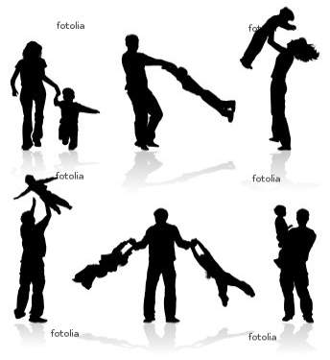
親子關係轉化愛中成長
親子關係轉化…
一起在愛中成長…

